Slide 1

SLIDE 1
Tech_Army
UTKARSH MISHRA (Team Leader)
Phone No- 9810420078
RITIK TAYAL (Member)
Phone No- 7017633866
Domain- Augmented Reality
Problem statement- Open Innovation

Slide 2
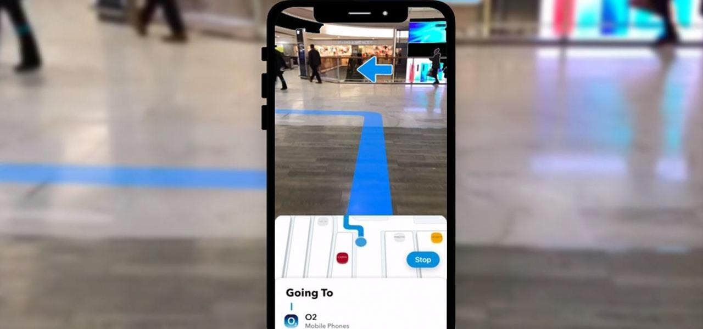
SLIDE 2
ABSTRACT
It is always annoying and dangerous to look at your small 2d map to navigate while driving a car. Would not it be better if we had something directly in front of us, say on the windshield of your car, that is not distracting but also helps you in navigation. Here comes AR based navigation to the rescue. We directly project or “augment the path” from our app onto the windshield which removes the need to divert your focus while driving. It is designed and blended in such a way so that the projection is not distracting rather complements the driving experience.
Indoor navigation is a problem everyone encounters, be it someone visiting a museum, employees. getting started with work, you are shopping in a big mall or sometimes as crucial as finding OTs, dispensaries in a hospital.

Slide 3
SLIDE 3
NOVELTY
Our app will be offering indoor navigation in big complexes places like shopping malls. warehouses etc. In big MNCs, warehousing methods and logistics play a vital role in keeping the supply chain rolling and working. Various methods are used for indoor navigation in these complexes. such as embedded computers that give you direction according to your location or maps on 2D. screen computers. Most of these solutions require a lot of infrastructure and investment. We have tackled this problem by providing a complete AR based indoor navigation system with no heavy infrastructure requirement.

Slide 4
SLIDE 4
TECHNOLOGY
STACK
Our application will be using Unity Engine, Google AR Core, Vuforia .

Slide 5
SLIDE 5
SOFTWARE IMPLEMENTATION
Have you ever felt lost because it was your first time there? Whether it was an airport, a mall, or a grocery store, hospital. Do you face a problem traveling around a city with ease? (maybe if you have
just moved to that city or maybe you just are stuck in traffic?). It is a general problem that one feels unfamiliar with the procedures to be followed there. Furthermore, it is. hard to find things such as Information Desk or Restrooms. Worse case, the person may have disabilities like blindness or muteness. GPS navigation may help you in getting from one place to another, but it cannot be specific to guide you through every single building in the entire city and sometimes cannot really help people who have disabilities. Who? can possibly be our hero?

Slide 6
SLIDE 6
So, we want to develop a mobile application with AR Technology which could be mirrored on the windshields of the Vehicles completely replacing the need of a smartphone to be looked at. This will be coupled up with a synced mobile application which would continue the navigation indoor through the mobile in AR. The final aim will be to project directional arrows navigating the user to his destination using Augmented Reality on the windshield of the vehicle. In this duration we aim to build an android AR application which will implement navigation and create a visually attractive application.
It will help customers navigate in the real world. It is estimated that the proliferation of AR based. inland navigation in different consumption sectors will grow tremendously over the next few years. as technologies evolve. As users become more digital savvy and ready to apply new technologies in their daily lives.

Slide 7
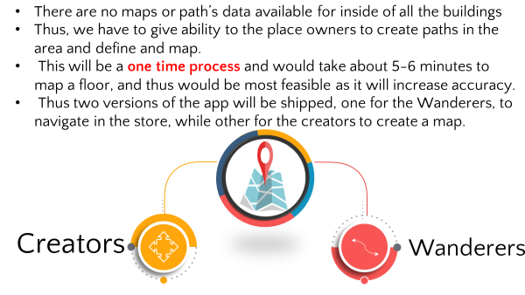
SLIDE 7
BUSINESS SCOPE

Slide 8
SLIDE 8
Thank You

